Slide 1


Institute of Technology of Cambodia
Department of Mechanical and Industry
Water Tank Filling Time
Water Tank Filling Time
Subject : Numerical Method
Prof : Mr. KEO CHIVORN
Group : I4-GIM-Mec
Student’s Name ID
Ban THUNPISEY e20220860
CHAO SIVCHHUONG e20220409
CHIEB CHEY e20220235
CHHOM VANNTHUON e20220432

Slide 2
Contents
I. Introduction (Title & Team Roles)
II. Objective (The Engineering Problem)
III. Methodology
The Mathematical Model
Method Selection & Justification
Comparing Alternatives
Implementation & Tools
IV. Results (Results & Visualization)
V. Evaluation (Error Estimation & Validation)
VI. Limitations
VII.Conclusion
VIII. References

Slide 3
I. Introduction
Water Tank Filling Time
The engineering problem addressed in this project is determining the mathematical relationship between the height of water in a tank and the time required to fill it. In engineering design, tracking fluid levels over time is essential for sizing infrastructure and preventing system overflows. However, because the equations relating fluid height and time can be non-linear and difficult to solve directly using standard algebra, finding the exact time for a specific water height requires finding the roots of these engineering functions.
Teammate & Role
CHIEB CHEY CHAO SIVCHHOUNG CHHOM VANNTHOUN BAN THUNPISEY
e20220235 e20220409 e20220432 e20220860
- Define the equation of the problem
- Target the objective
- Methodology graphical
- Software analyse
- Calculate the equation
- Choose the methods
- Evaluation the result
- Check the result

Slide 4
II. Objective
To apply Numerical Method to solve real problem
To find the volume flow rate to define the right time
To define the better method
To understand how to determine the equation of the problem
To know how to read graphic of result
To evaluate the result
To discussion and recommendation

Slide 5




III. Methodology
The Mathematical Model
2. Method Selection & Justification
3. Comparing Alternatives
4. Implementation & Tools

Slide 6
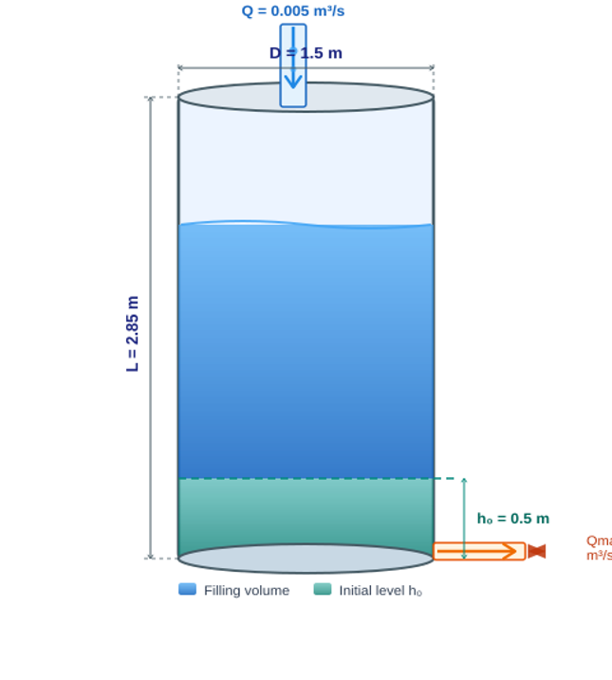
1. The Mathematical Model
Problem Statement
In engineering, knowing how fast a tank fills up is a common and critical design problem. As water flows into a cylindrical tank, the height increases over time depending on the shape of the tank and the flow conditions.
Physical Constraints
L : Height of tank: 2.85 m
D : Tank diameter: 1.5 m
h₀ : Initial water level: 0.5 m
A : Cross-sectional area: 1.76625 m²
Q : Volume flow rate: 0.005 m³/s
Q_max : Maximum outlet flow rate: 0.003 m³/s
τ : Time constant: 30 s
Goal: Determine the total time required to fill the tank to full capacity given the net inflow and physical constraints

Slide 7
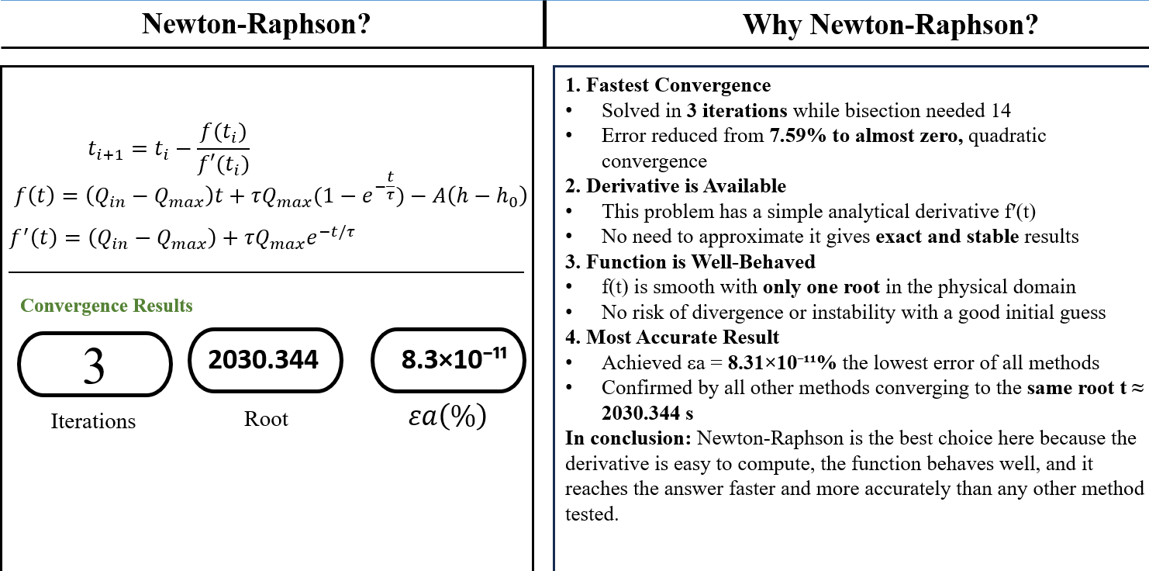
2. Method Selection & Justification

Slide 8
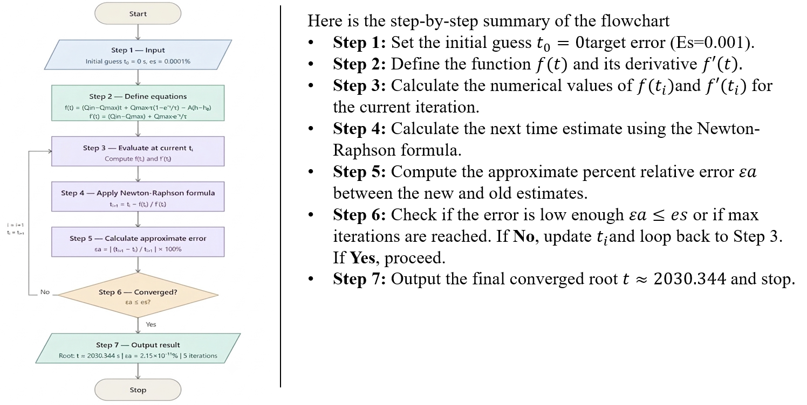
2. Method Selection & Justification
A brief flowchart showing how the chosen algorithm works step-by-step

Slide 9
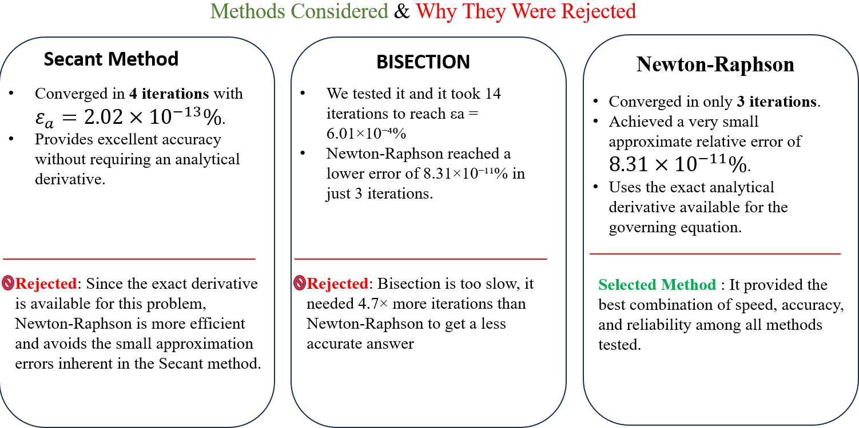
3. Comparing Alternatives

Slide 10
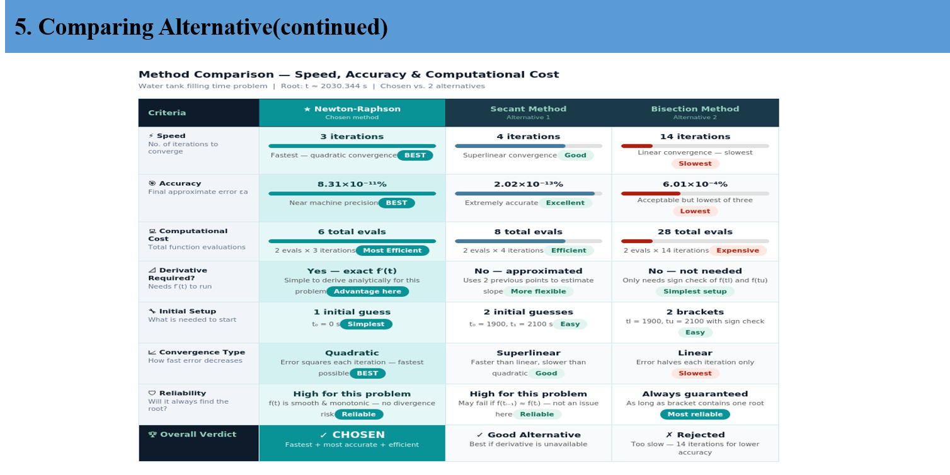
3. Comparing Alternatives

Slide 11
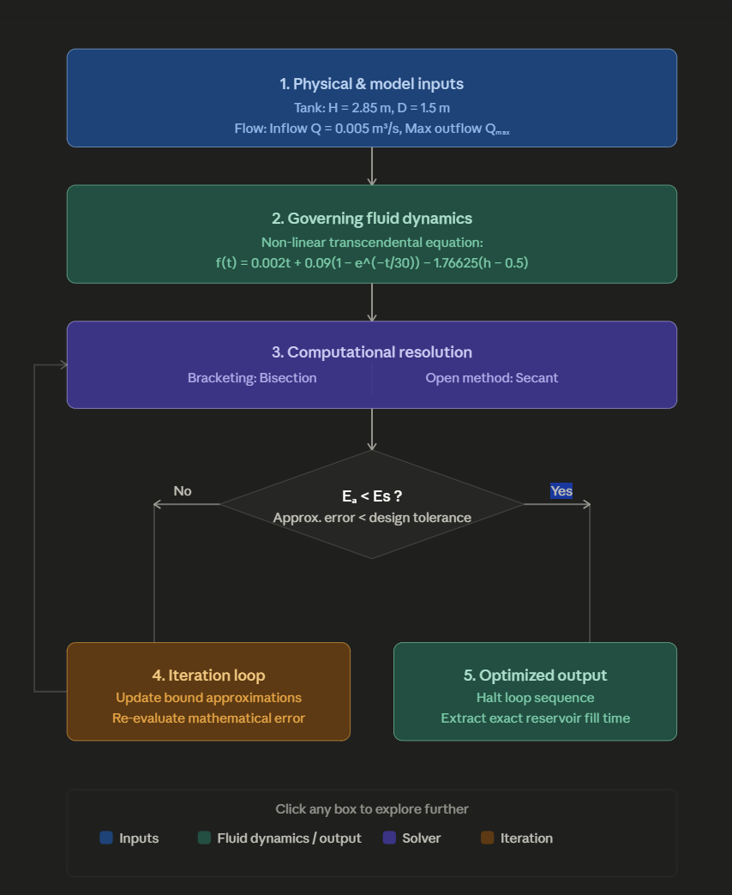




4. Implementation & Tools
Digital Software Suite
The Logic Flowchart
Computational Framework Strategy:
Data Prototyping (Excel & VBA): Utilized for initial system mapping, physical parameter compilation, and boundary condition structuring.
Algorithmic Engine (MATLAB & Python): Leveraged to implement high-performance, non-linear transcendental solvers (Bisection and Secant loops).
Cross-Platform Validation: Solution criteria were systematically processed across independent environments to guarantee 0.00% convergence variance.

Slide 12
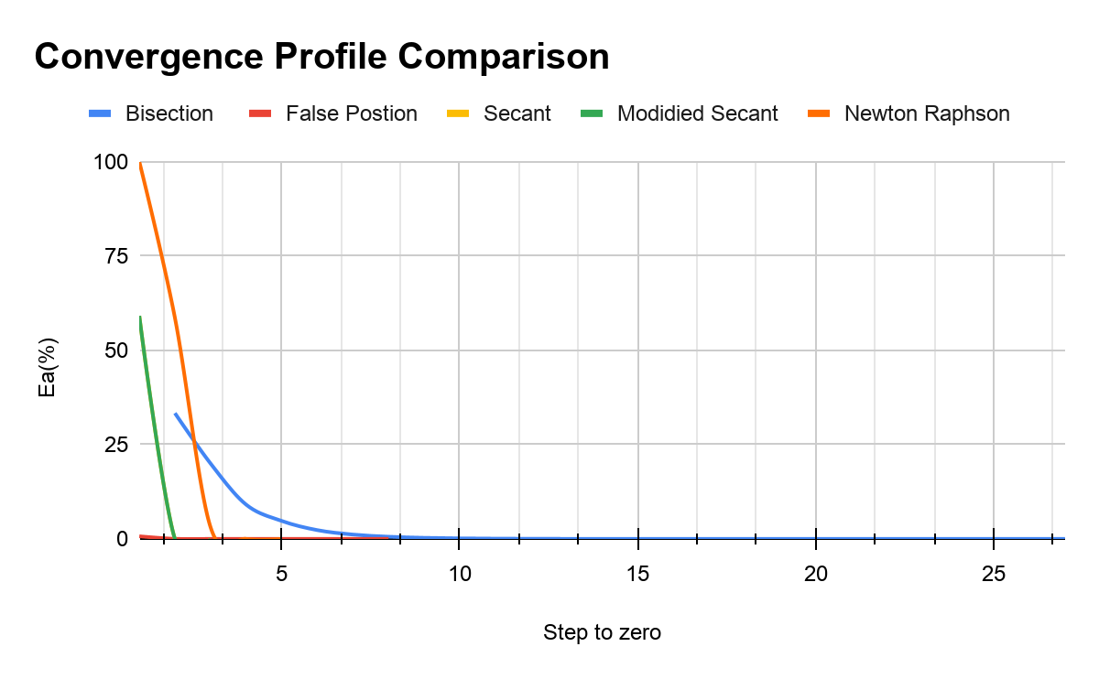
IV. Result
Method | Iterations | Final Error (%)
Graphical | — | —
Bisection | 14 | 0.0006
Position | 2 | ≈ 0
Fixed-Point Iteration | 11 | ≈ 0
Newton-Raphson | 3 | 8.31 × 10⁻¹¹
Secant | 4 | 2.02 × 10⁻¹³
Modified Secant | 4 | 3.92 × 10⁻¹³
Executive Summary: Core Rules for Graph Interpretation
1. The Baseline Framework (Axes): The vertical axis Ea measures error magnitude, while the horizontal axis tracks the discrete computational steps (iteration count) taken to drive that error to zero.
2. Rate of Convergence (Slope): The steepness of the line visually dictates algorithmic speed. A near-vertical drop proves rapid quadratic/superlinear convergence. (e.g., Newton-Raphson), whereas a shallow, extended slope indicates slow linear convergence (e.g., Bisection).
3. The Microscopic Scale Limit (The Flatline): On a standard macro scale 0 % to 100%, high-efficiency open methods appear to merge and perfectly flatline at zero. Thorough engineering analysis requires looking past this visual illusion to verify the exact micro-level precision values mathematically.

Slide 13
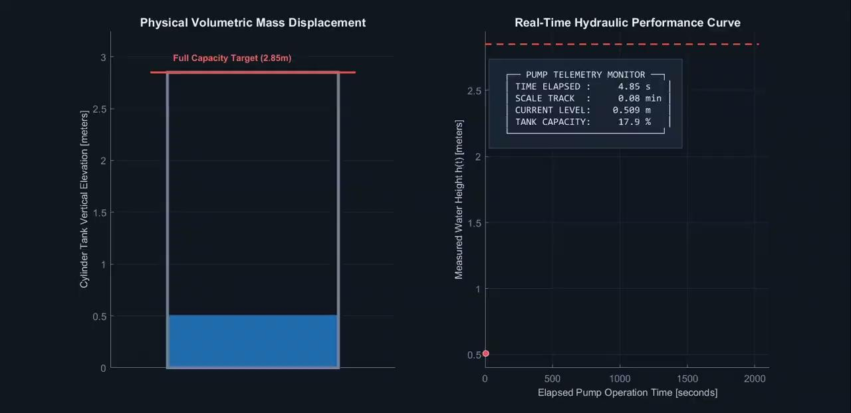
IV. Result

Slide 14
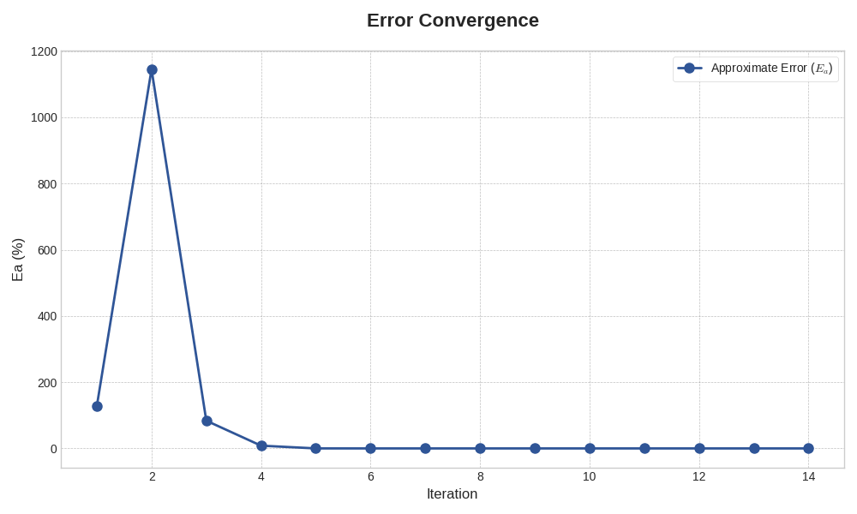
V. Evaluation
Convergence: The graph shows E_a decreasing with each iteration, proving the numerical method approaches the true root.
Validation: By comparing the Approximate Error (E_a) against the predefined tolerance (E_s), we confirm the stopping criterion was met, ensuring result validity.
Efficiency: The rapid drop in error demonstrates the high efficiency and quadratic convergence characteristic of the Newton-Raphson method.

Slide 15
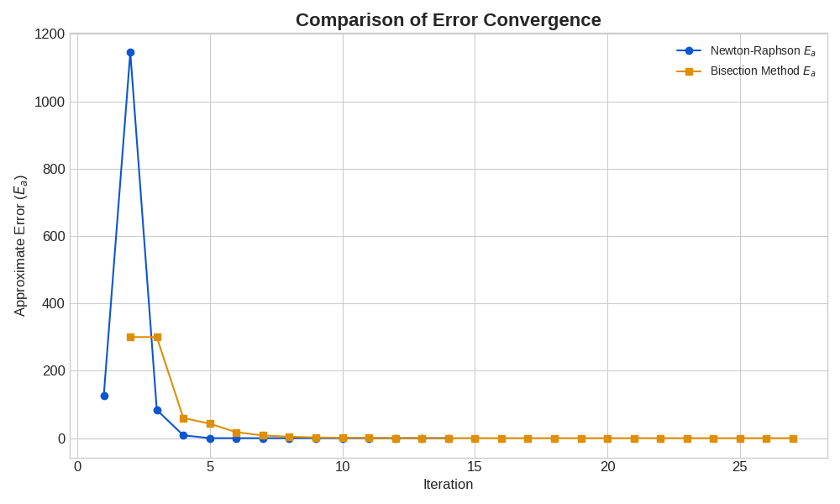
VI. Limitations
Convergence Risks :Newton-Raphson: May fail if f'(x) =0 (division by zero) or if the initial guess (x_i) is poor, leading to divergence.
intentionally stop early once the error is "small enough" (based on tolerance E_s), so we don't reach the absolute exact infinite decimal.
Finite memory can introduce round-off errors at extremely small scales.
Method Assumptions: Models require the function to be continuous and differentiable within the region of interest.

Slide 16
VII. Conclusion
Both the Newton-Raphson and Bisection methods successfully converged to the root. The systematic decrease in Approximate Error confirms that our numerical models are stable and reliably approaching the exact root.
The Newton-Raphson method achieved convergence in nearly half the iterations of the Bisection method (14 vs. 26), proving it is the superior, time-saving tool for complex, speed-critical engineering calculations.
Our results are trustworthy because we verified precision using error estimation , ensuring every solution meets strict safety and quality standards.

Slide 17
VIII. References
Link to google slide: https://docs.google.com/presentation/d/1KV_qctCFiBf72FuRUt2mtzY5Ub-EnY3tVvN8oIdzotc/edit?usp=sharing

Slide 18
Thank You.
Any Question??

